Slide 1
AIM
Closed- circuit television (CCTV) system is globally used to monitor activities . It
has found its usage in every aspect of platform , whether to be of security
purpose of domestic and commercial buildings to monitor and record for activities covering a whole city.
Since usually CCTV is used to just monitor and record visual footage to be examined later by an individual, In this project we have tried to create such a system which uses the old properties of CCTV system along with smart features to provide a more better secure environment.
This system provide us with three smart features which can be used widely
Face Detection
Motion Detection
Object Detection (Social Distance Violation Detection)

Slide 2
Introduction
What is computer Vision
Computer Vision is an interdisciplinary field that deals with how computers can be made to gain a high-level understanding from digital images or videos
We all use Facebook, correct? Let us say you and your friends went on a vacation and you clicked a lot of pictures and you want to upload them on Facebook and you did. But now, wouldn’t it take so much time just to find your friends faces and tag them in each and every picture? Well, Facebook is intelligent enough to actually tag people for you.
So, how do you think the auto tag feature works? In simple terms, it works on computer vision.
The idea here is to automate tasks that the human visual systems can do. So, a computer should be able to recognize objects such as that of a face of a human being or a lamppost or even a statue

Slide 3
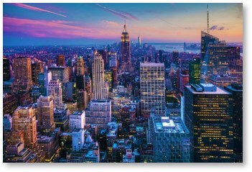
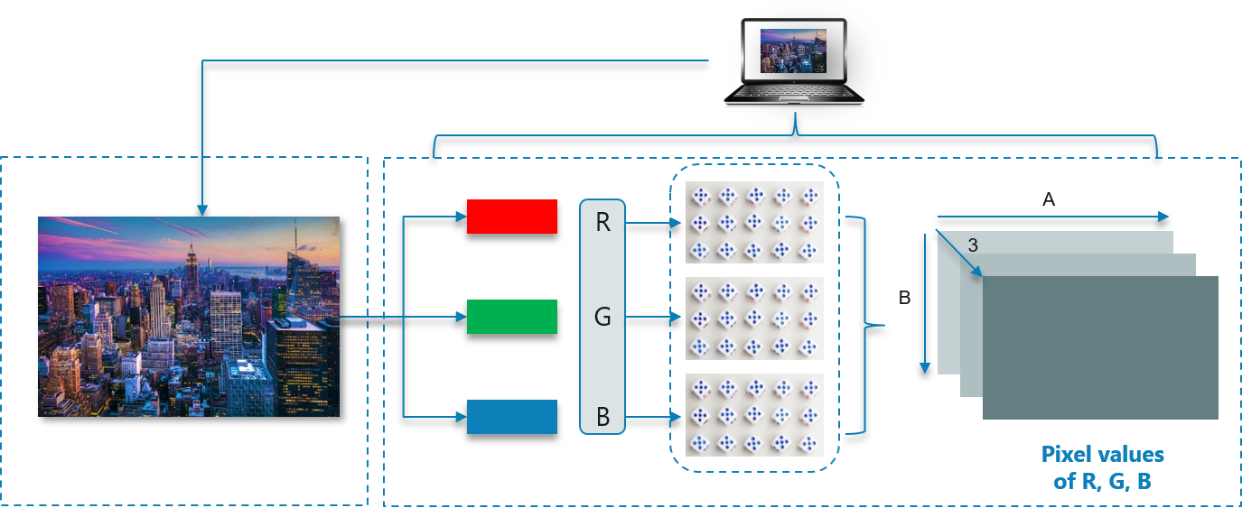
Consider an Image

Slide 4
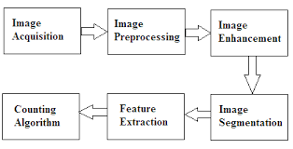
Need of Image Processing
The data that we collect or generate is mostly raw data, i.e. it is not fit to be used in applications
directly due to a number of possible reasons. Therefore, we need to analyze it first, perform the
necessary pre-processing, and then use it.
Image Processing is the subset of Computer Vision

Slide 5
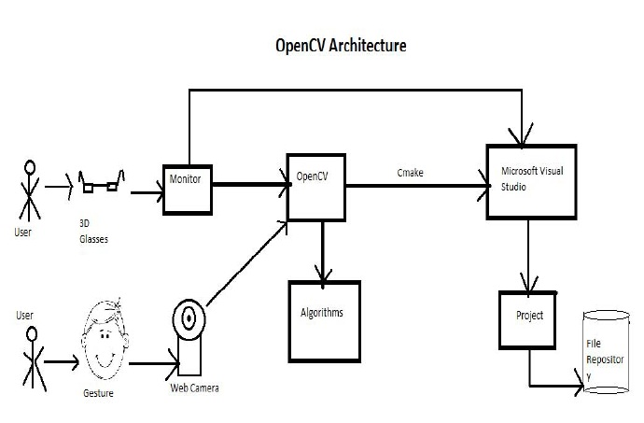
Open CV
Open CV is a cross-platform library using which we can develop real-time computer vision
applications. It mainly focuses on image processing, video capture and analysis including
features like face detection and object detection.
Open CV is a Python library which is designed to solve computer vision problems

Slide 6
Benefits of Open CV
Using OpenCV library, you can −
Read and write images
Capture and save videos
Process images (filter, transform)
Perform feature detection
Detect specific objects such as faces, eyes, cars, in the videos or images.
Analyze the video, i.e., estimate the motion in it, subtract the background, and track objects in it.

Slide 7
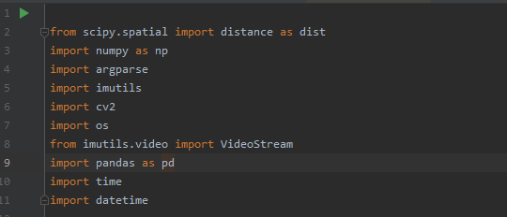
Necessary Packages

Slide 8
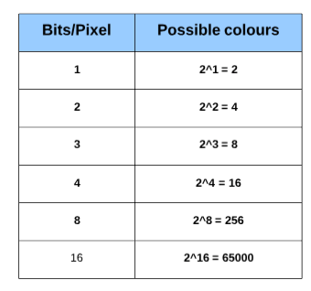
Basics of image
Image as an Array
An image is nothing but a standard Numpy array containing pixels of data points. More the number of pixels in an image, the better is its resolution
Number of colors/shades = 2^bpp where bpp represents bits per pixel

Slide 9
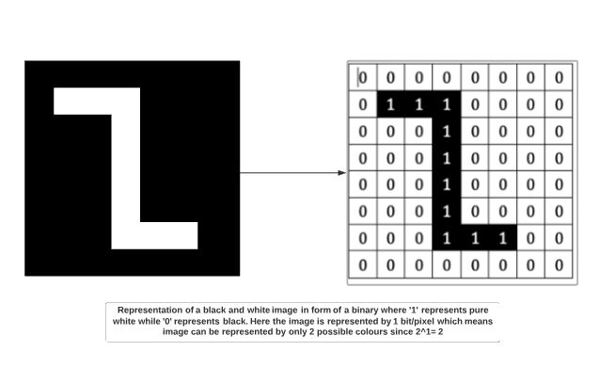
Types of images
Binary Image
A binary image consists of 1 bit/pixel and so can have only two possible colors, i.e., black or white. Black is represented by the value 0 while 1 represents white.

Slide 10
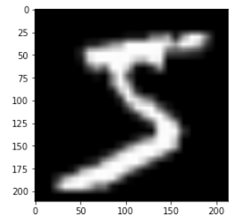
Gray scale Image
A grayscale image consists of 8 bits per pixel. This means it can have 256 different shades where 0 pixels will represent black color while 255 denotes white. For example, the image below shows a grayscale image represented in the form of an array. A grayscale image has only 1 channel where the channel represents dimension.

Slide 11
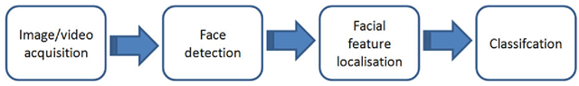
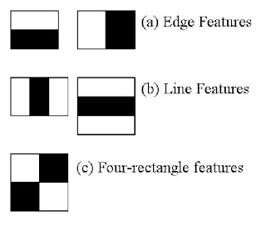
Face Detection
Haar Cascade classifier
Haar feature considers adjacent rectangular regions at a specific location in a detection window, sums up the pixel intensities in each region and calculates the difference between these sums.

Slide 12
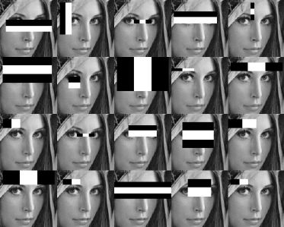
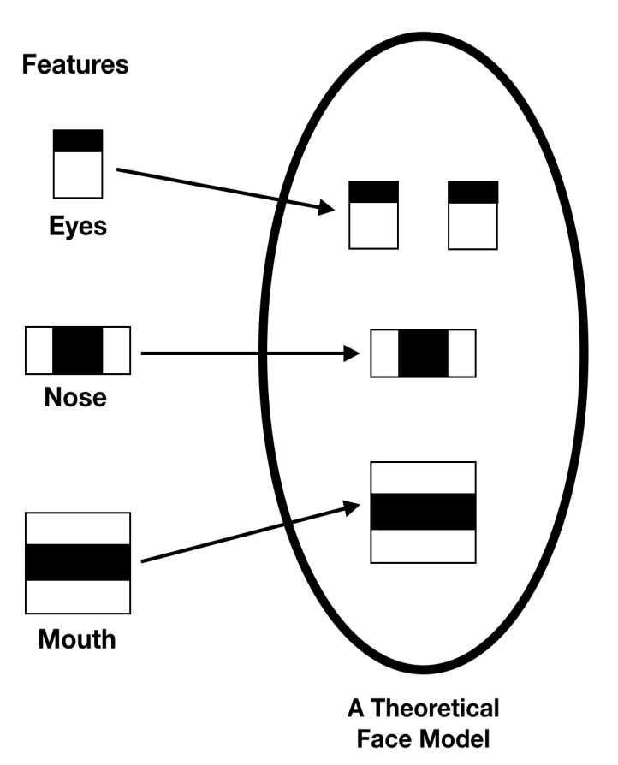

Slide 13
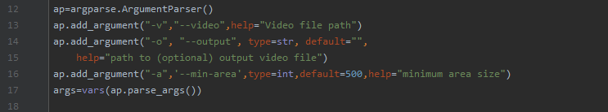
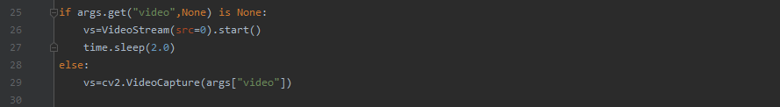
Implementing the code

Slide 14
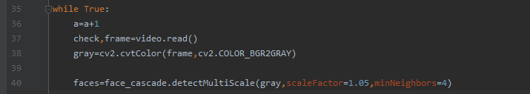
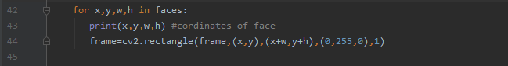
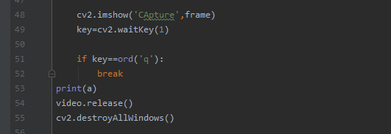

Slide 15
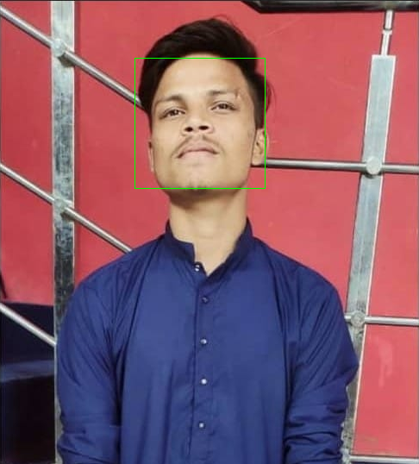
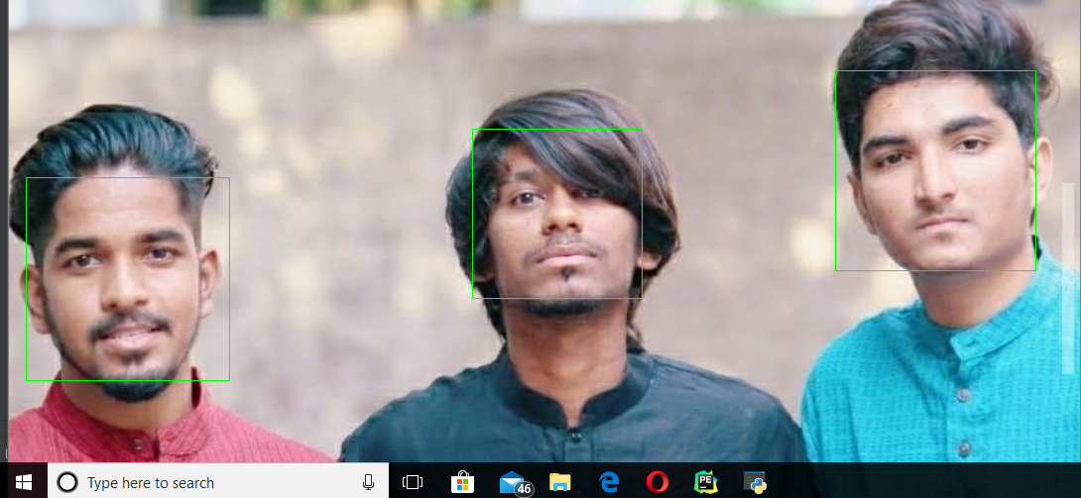
Output

Slide 16
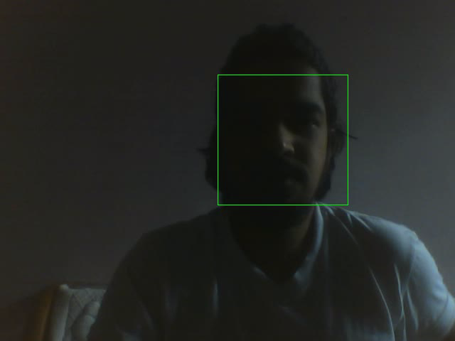
Video Output

Slide 17
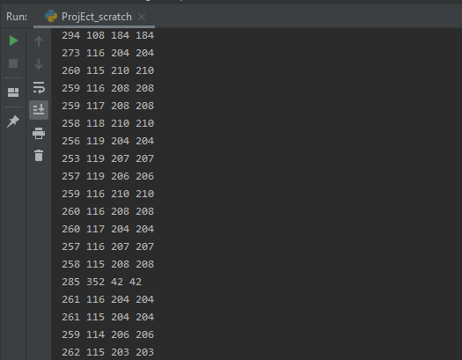
Numpy arrays of pixel value
4 values represent the following coordinates for example consider the last array
262 = x coordinate
115=y coordinate
203 = width
203= height

Slide 18
Motion Detection
Concept
This part of the code works on the principal of background subtraction
As our source is fixed at a place and also the background of the frames is not moving , we can model the background, we monitor it for substantial changes. If there is a substantial change, we can detect it — this change normally corresponds to motion on our video
The absolute difference is computed to subtracting the background before compute the
binary image of the moving objects using a threshold. This threshold is also used to
update the background at each new image

Slide 19
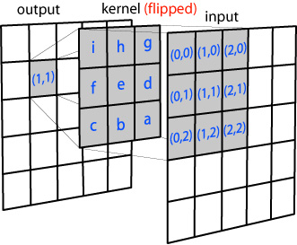
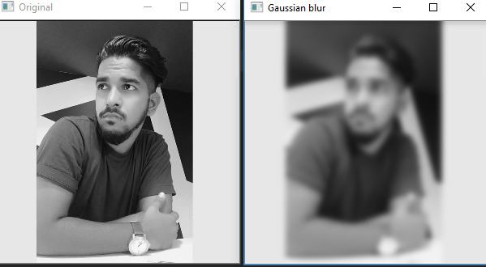
Using Gaussian Blur to produce Threshold

Slide 20
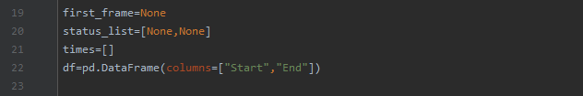
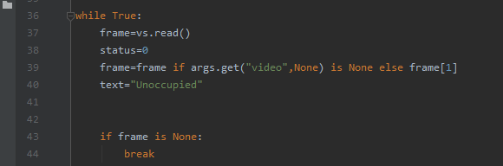

Implementing The code

Slide 21
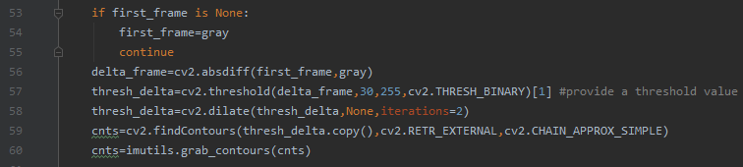
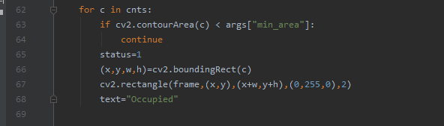

Slide 22
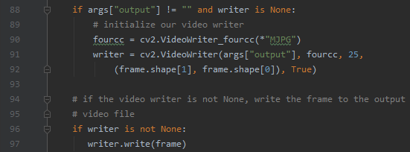
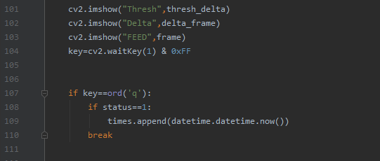

Slide 23
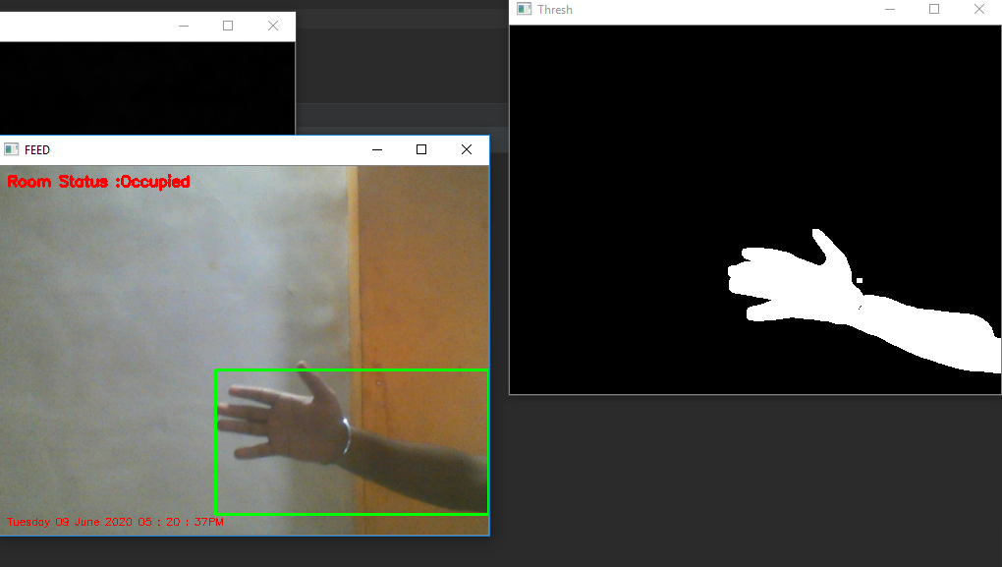
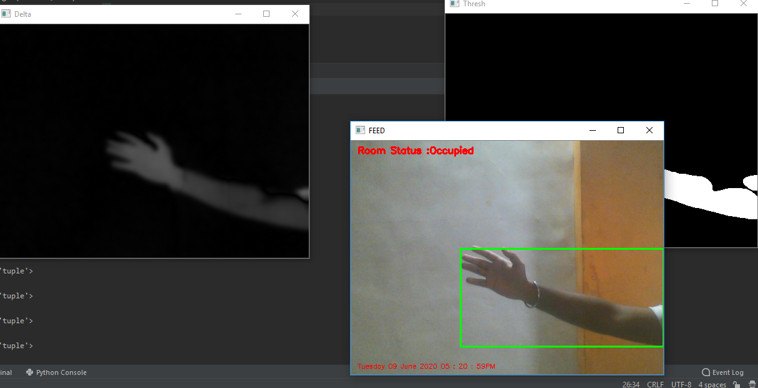
Output

Slide 24
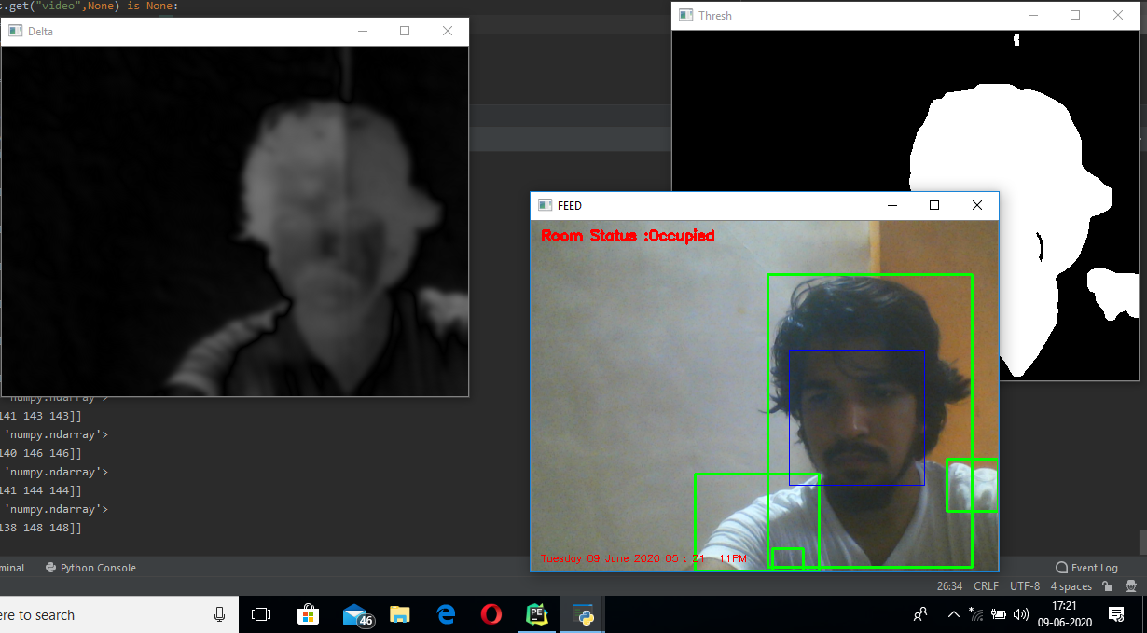
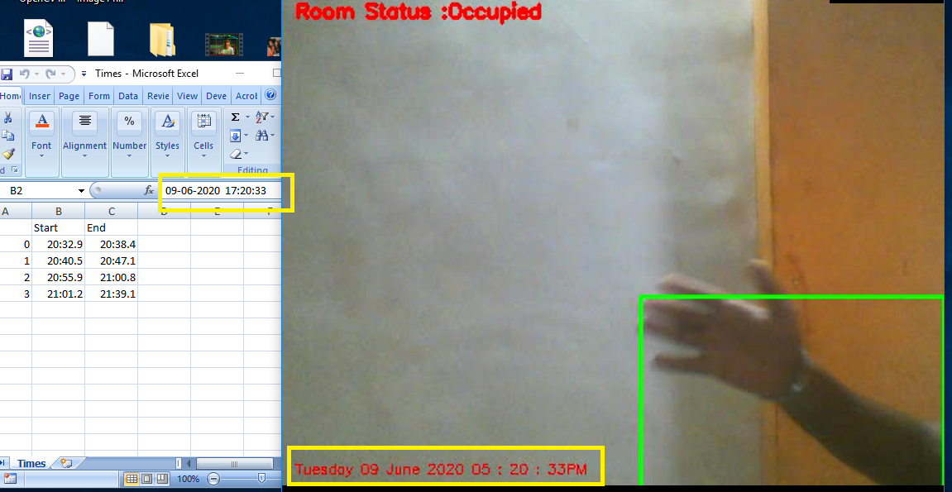

Slide 25

Output Video

Slide 26
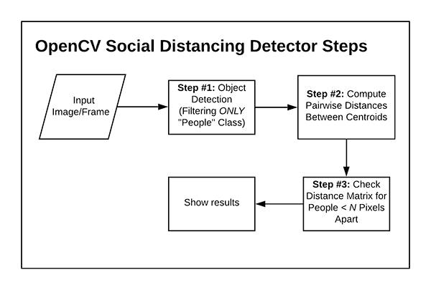
Object Detection
Social Distancing violation Detector

Slide 27
Concept
7.3 Basic Concept:
Apply Object Detection to Detect all the people in a given frame
Compute pairwise Distance between the peoples
Based on these distance , we detect if any two people are less than N-pixel apart
This is basically an object detection code , which treats people as an object and detect
them,
The algorithm provides us with the with the centroid value
(centre x , centre y , width and height) of the people which is represented as green box

Slide 28
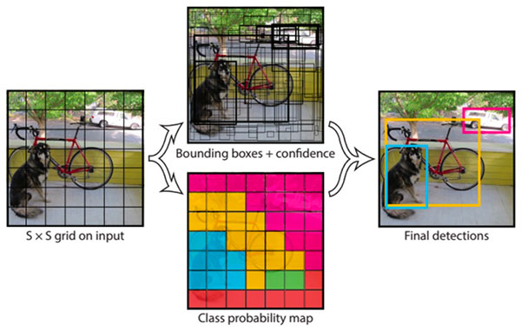
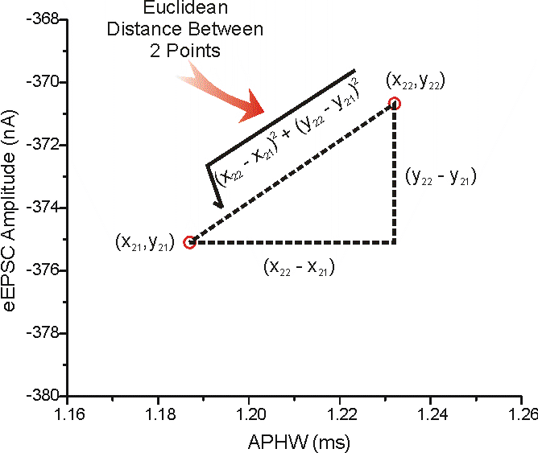
YOLO Detection

Slide 29
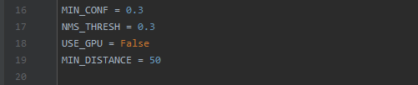
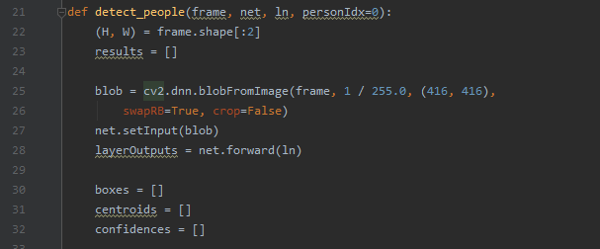
Implementing the code

Slide 30
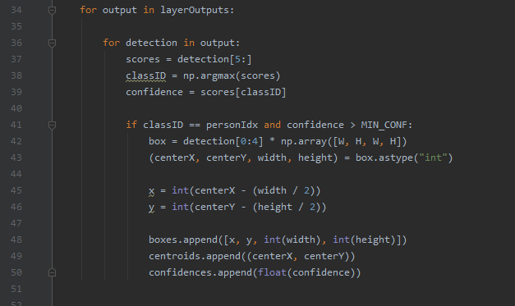

Slide 31
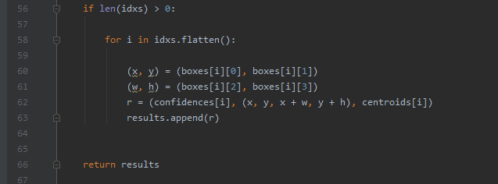
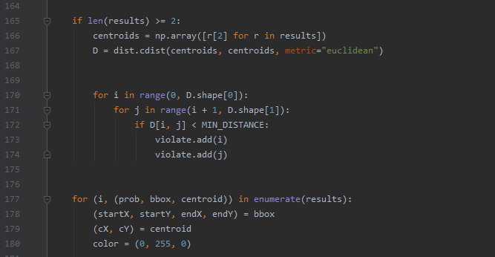

Slide 32
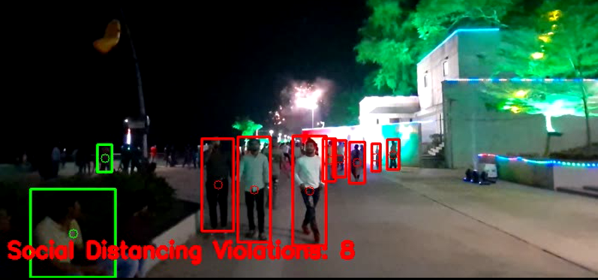
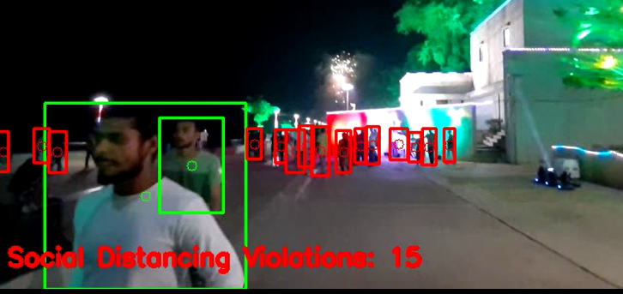
Output

Slide 33
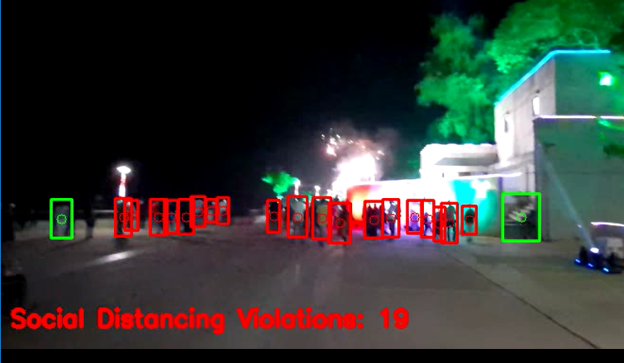

Slide 34
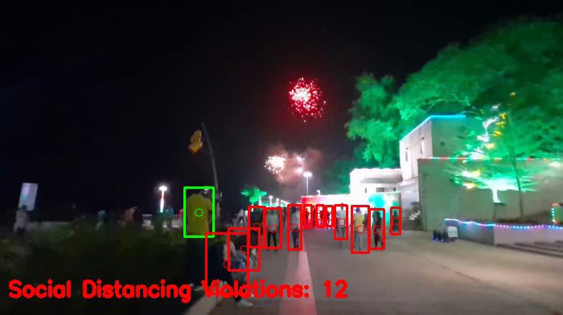
Output Video

